Slide 1
HNDIT2417
Mobile Application Development
Build and Run

Slide 2

Building the app
Gradle is open source build automation tool, to build the app's application package (APK) file.
  An apk file gets signed and pushed to the device using ADB(Android Debug Bridge)

Slide 3
Running Options
Run on Android emulator in PC
Run on a real device
  Install on real device

Slide 4
1.Running on Android Emulator
Android Emulator
  Android Emulator simulates Android devices on computer so that developer can test applications without physical device.
  Android Emulator uses an Android virtual device (AVD) to specify the Android version and hardware characteristics of the simulated device.

Slide 5
Android virtual devices
Android Virtual Device (AVD) defines the characteristics of an Android phone, tablet, Wear OS, or Android TV device that you want to simulate in the Android Emulator.
AVD contains a hardware profile, system image, storage area, skin, and other properties
AVD works with the emulator to provide a virtual device-specific environment to install and run Android apps.

Slide 6

AVD Manager
AVD Manager is an interface which developer can launch from Android Studio that helps to create and manage AVD.
Select Tools > AVD Manager.

Slide 7
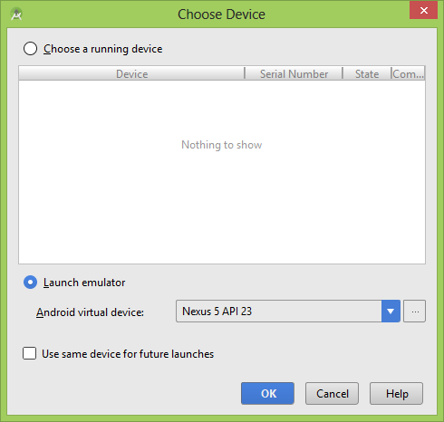

Slide 8
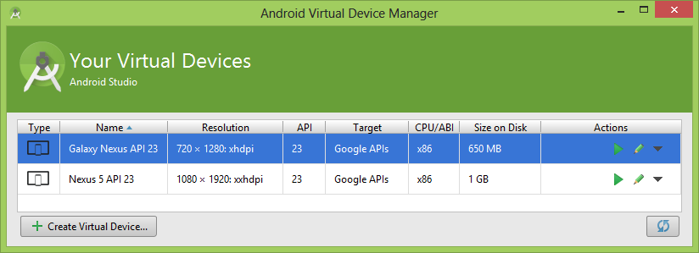
Android virtual devices

Slide 9

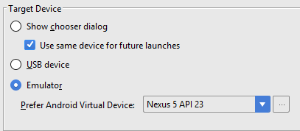
Run/Debug Configurations
Can define a configuration for one-time use, or save it for future use.

Slide 10
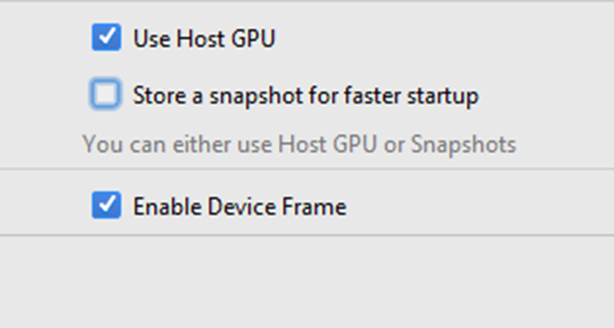
Snapshots
Snapshot is a stored image of an AVD that preserves the entire state of the device at the time including OS settings, application state, and user data.
Multiple snapshots can be saved for each AVD

Slide 11
Snapshots
Advantages
  Saving the time of waiting for the operating system and applications on the virtual device to restart.
  Saving the effort of bringing testing app back to the state at which want to resume testing.

Slide 12
Snapshots
Save general snapshots
  Snapshots category, and click the Take snapshot
Delete a snapshot
  Extended controls window, select the Snapshots category, select the snapshot, and click the delete
Load a snapshot
  Extended controls window, select the Snapshots category, choose a snapshot, and click the load

Slide 13
Quick boot
By default, each AVD is set to automatically save a quick-boot snapshot on exit and load from a quick-boot snapshot on start.

Slide 14

Disable Quick Boot
Select Tools > AVD Manager and click Edit this AVD .
Click Show Advanced Settings and scroll down to Emulated Performance.
Select Cold boot.

Slide 15
2.Android Package (APK) on real device
  Android Studio saves the APKs you build in project-name/module-name/build/outputs/apk/
  app-debug.apk
  Copy the app-debug.apk to mobile device
  Install the app-debug.apk
  The default security settings of the device will not let the app installed whish is from unknown source

Slide 16
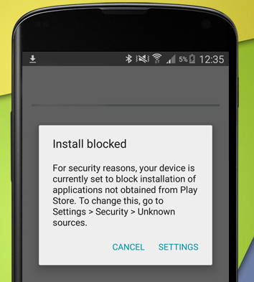
Install app from Unknown Source
Go to
  Settings > Security > Unknown sources
  Disable default security settings

